Slide 1

Gradient boosting machines: a comparison between different approaches Francesco Maria Calistroni Giuseppe Capizzi Lorenzo Tausani Elisa Tremolada Optimization for data science – Final project Master degree in Data Science 2021/06/22

Slide 2
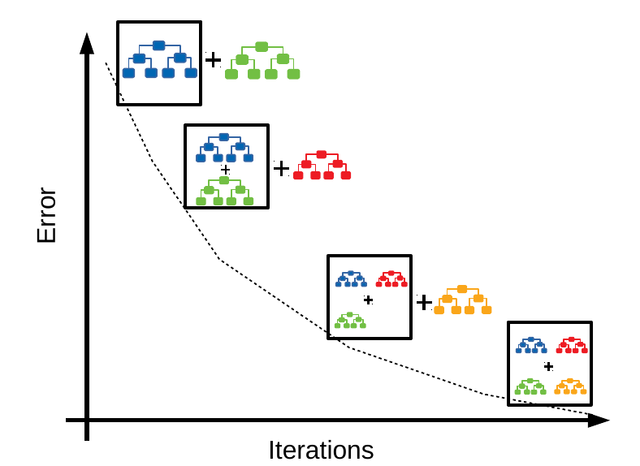
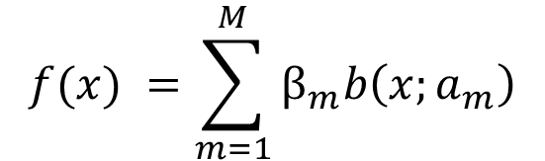
What is gradient boosting (GBM)?
combining multiple weak learners (i.e. an ensemble of weak learners (WL)) together produces a strong machine learning model
Weight coefficient
Input variables
Parameters of b
$$f(x) =\sum_{m=1}^{M}{β_{m}b\left(x;a_{m}\right)}$$
WL are combined by additive expansions
Parametrized model function (e.g. decision tree)

Slide 3
Gradient boosting: applications
Very flexible method: GBM is applicable to various forms of classification and regression tasks. Moreover, it can be used with a variety of weak learners (e.g. decision trees (the most common), but also other models, such as support vector machines)
Numerous variants of GBM have been developed in recent years. In particular:
Accelerated Gradient Boosting Machine (AGBM)
Randomized Gradient Boosting Machine (RGBM)
↔ Nesterov’s momentum
↔ (Random and greedy) batch
gradient descent

Slide 4
Aim of the work
develop the codes for GBM, AGBM, RGBM
Compare the algorithms following the work of Lu et al., 2020 , and Lu and Mazumder 2020.

Slide 5
Programming implementations details
All the codes related to the three methods were implemented following step-by-step the pseudocodes of the articles
The work is developed using Python programming language
Differently from the original implementation of Lu et al., 2020 we used the Scikit-learn Python’s library for the implemetation of the Decision tree algorithm

Slide 6
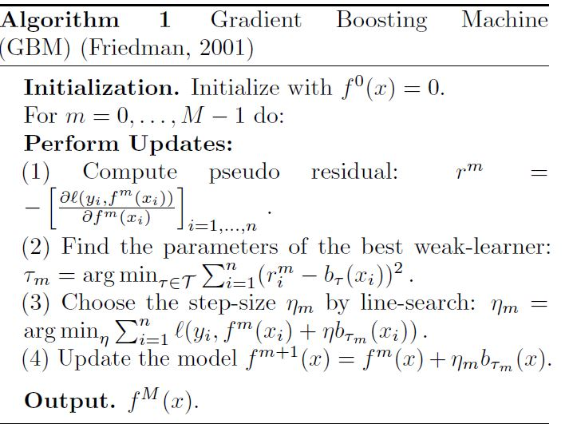
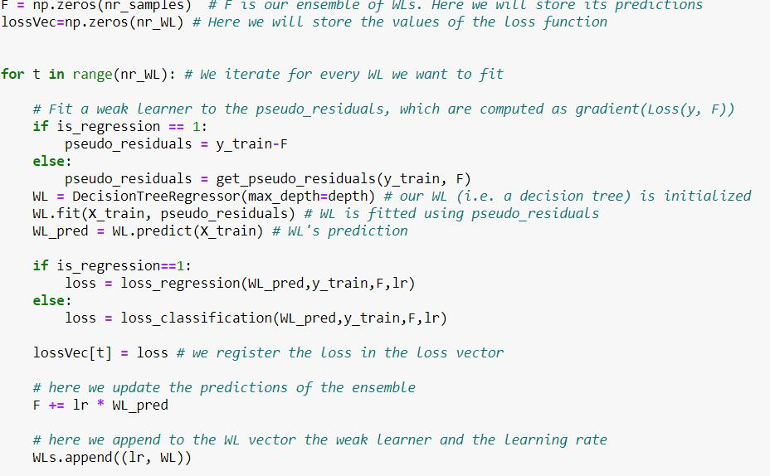

GBM: implementation

Slide 7
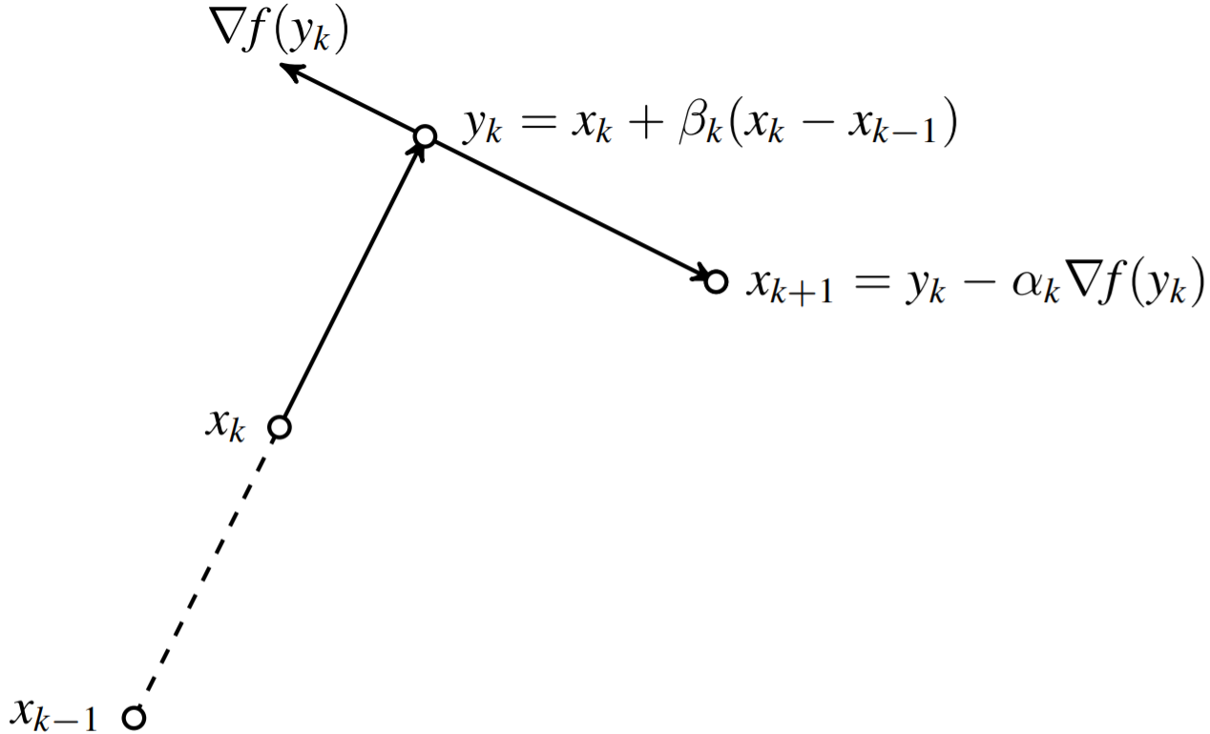
AGBM = GBM + Nesterov momentum
better rates of convergence than the gradient
Notes:
1 Extrapolation step: the method moves along the direction of the difference between the last two iterates, that is yk = xk + βk(xk − xk−1), with βk chosen depending on the properties of f ;
2 Gradient step: the method perform a gradient-like step at yk to get xk+1, that is xk+1 = yk − αk∇f(yk), with αk = 1/L and L Lipschitz constant of the gradient

Slide 8
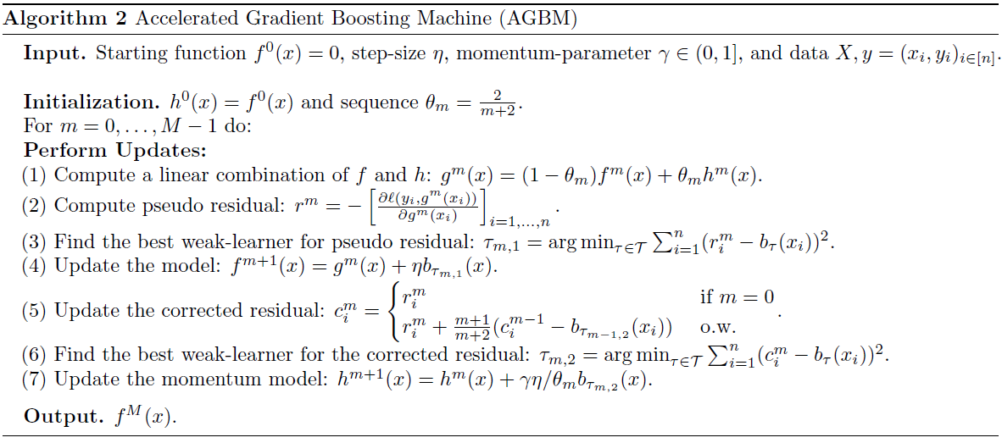

Slide 9
AGBM vs GBM: comparisons
Comparison between different learning rates (η = 0.01, 0.1, 1)
Classification task (dataset a1a; loss function= logistic loss)
WLs : decision trees with max depth = 4
Number of WLs = 1000
GBM vs AGBM with 3 different γ (γ = 0.1, 0.3, 0.5)
Comparison on multiple datasets
5 classification problems and 1 regression problem (in the latter case loss function = least squares loss)
Number of WLs = 30, 50, 100
GBM vs AGBM with γ =0.3 (Note: no random search with cross validation to find the optimal parameters as in Lu et al., 2020 due to our different implementation)
Models were trained and test on 5 different splittings of the dataset

Slide 10
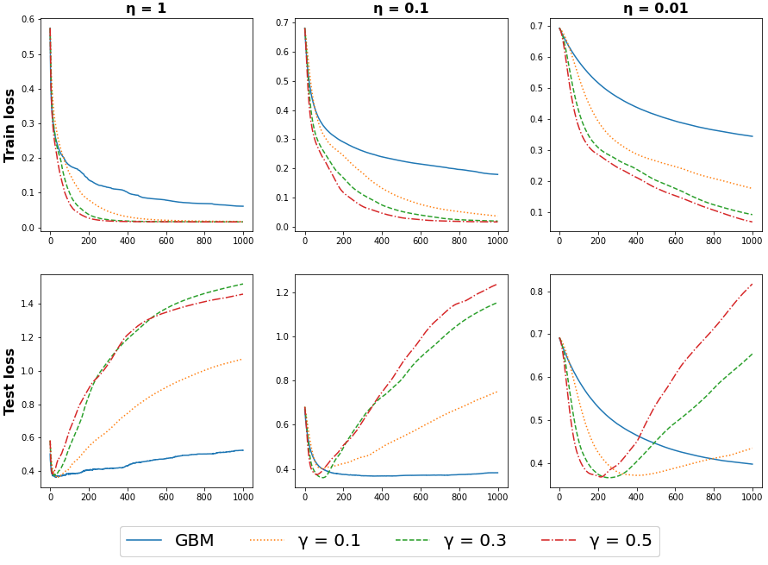
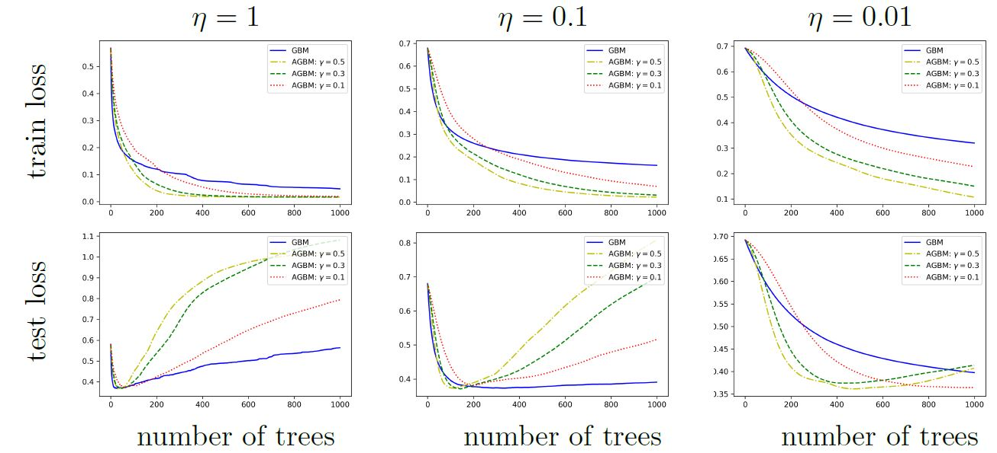
AGBM vs GBM, different η : our results…
AGBM vs GBM , different η : Lu et al., 2020
AGBM method reaches minimum test loss with less iterations compared to GBM.
AGBM tends to overfit with a higher number of iterations. → early stopping
Comparison with Lu et al., 2020
our AGBM models tend to reach the minimum test loss value in less iterations
show a stronger overfitting behavior
Our results might be motivated by the fact that we use all the observations instead of extracting 100 quantiles for fitting the decision trees

Slide 11
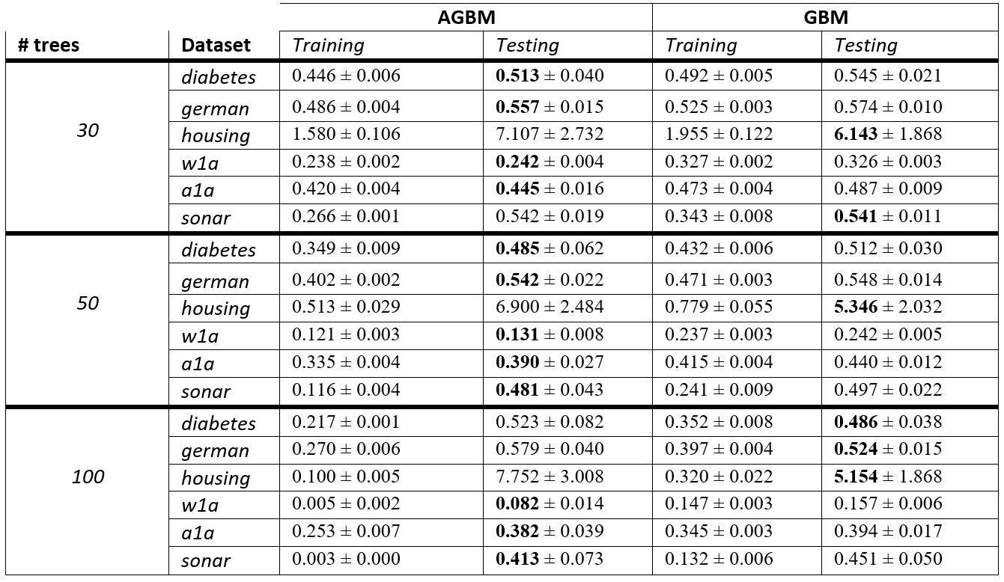
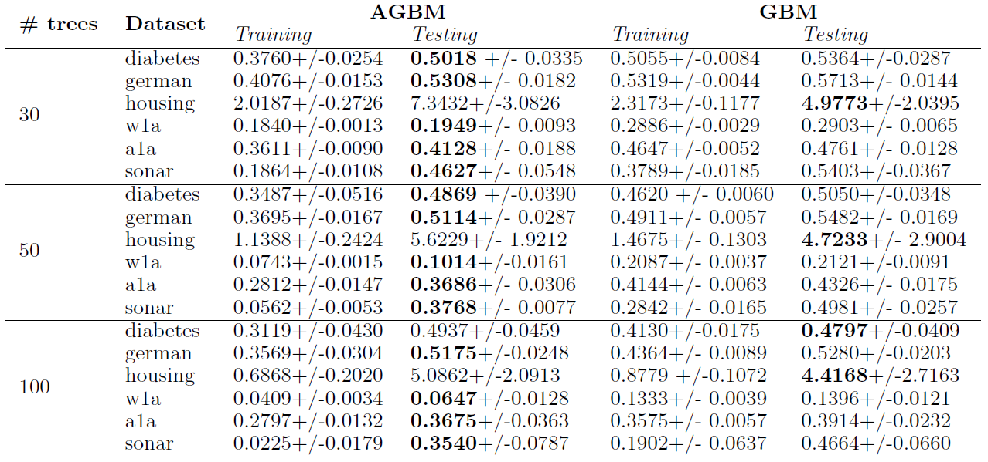
AGBM vs GBM, different datasets: our results…
AGBM vs GBM , different datasets : Lu et al., 2020
for a small number of weak learners (iterations), AGBM clearly outperforms GBM on different datasets
Despite we did not optimize the model’s parameters with random search, the trend observed in our losses clearly follows the one reported in Lu et al. 2020

Slide 12
RGBM: a brief introduction
A major cost in GBM computation is finding the parameters of the best WL
IDEA: diminish the computational cost by reducing the cardinality of the parameter space of the WL
→RANDOM THEN GREEDY APPROACH:
Randomly pick a subset of WLs
Choose the best WL parameters among the ones selected

Slide 13
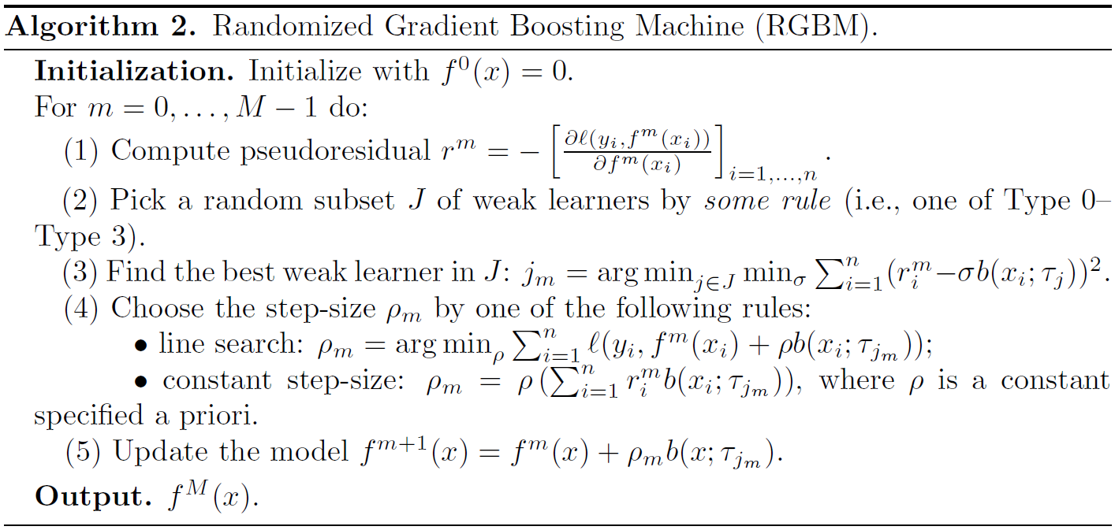

Slide 14
RGBM vs GBM: comparisons
Note: in the following comparisons GBM corresponds to RGBM with all features used to fit the WLs.
We controlled on dataset a9a that this implementation produces the same results of the first GBM implementation we presented.
Iterations vs. Running-Time
Classification task: (dataset a9a; loss function= logistic loss)
WLs : decision trees with max depth = 1 (stumps)
Selection rule : Type 3 (Random multiple group selection)
Number of WLs = 50 \ Runninng time = 50 secs
Fixed stepsize = 4
Running time with different datasets
4 different datasets
3 classification task and 1 regression task
Fixed stepsize: classification = 4; regression = 1
Notes:
Justify that fixed stepsize = 4 is taken from LU code

Slide 15
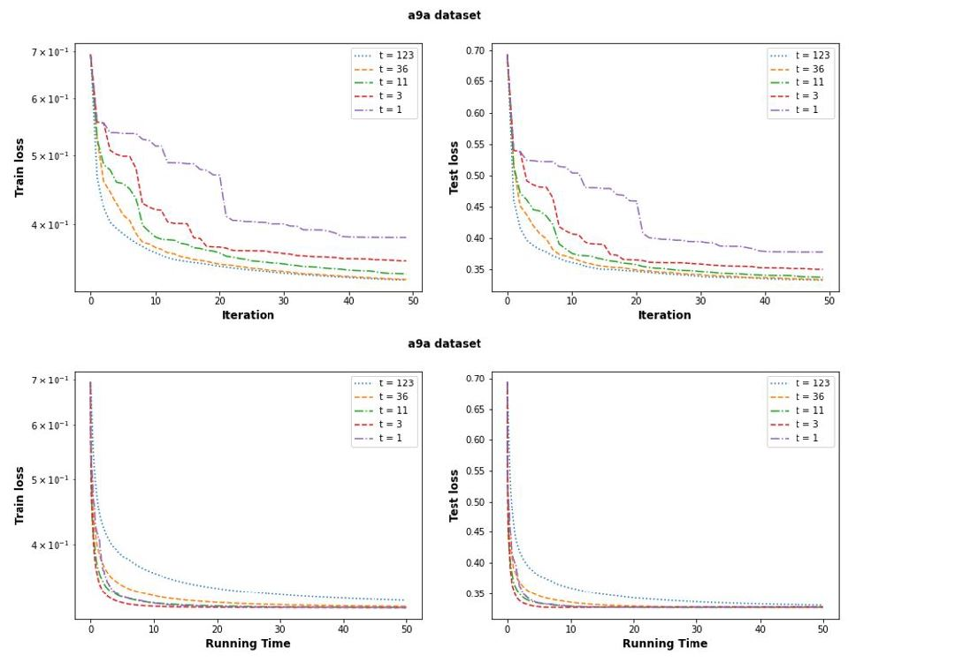
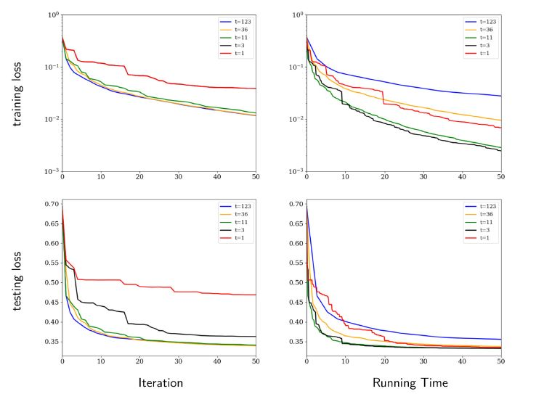
Iteration vs. Running time: results
RGBM converges before GBM in terms of running time, instead GBM converges faster in terms of iteration.
Notes:
Ricorda di dire che abbiamo il plot invertito rispetto a LU

Slide 16
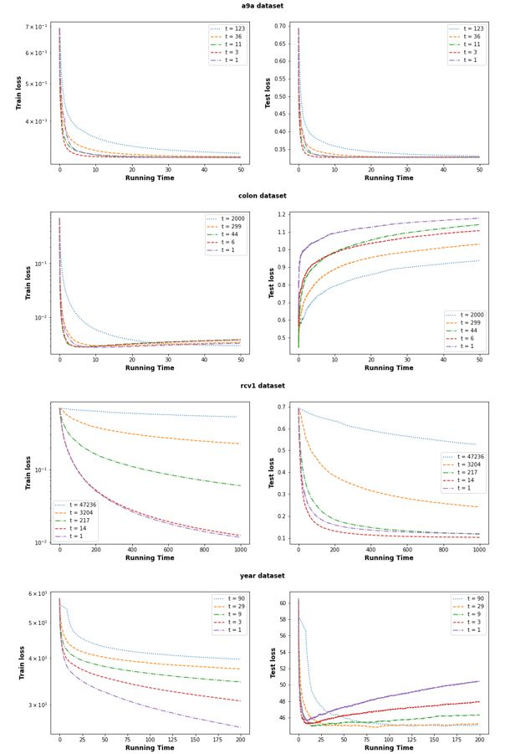
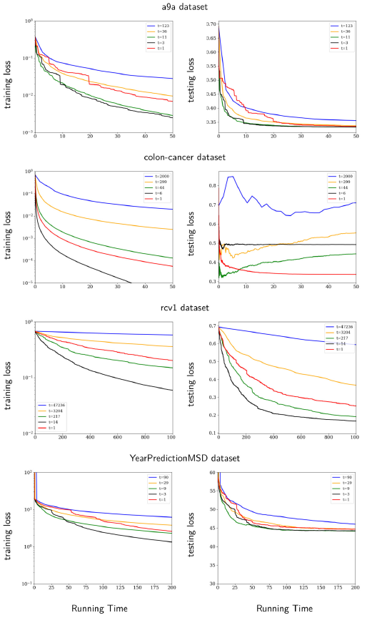
Also on other datasets, RGBM converges before GBM in terms of running time
Our results show major differences with the results on specific datasets analyzed in Lu et Mazumder 2020.
We do not have a coherent interpretation for the reasons behind these differences.

Slide 17
Conclusions
We implemented successfully GBM, AGBM and RGBM methods
We successfully replicated most of the theoretical results described in the works of Lu et al., 2020, and Lu and Mazumder, 2020.
Despite the differences in the implementations, most (though not all) differences in the results can be reconduced to reasonable interpretations

